Slide 1
Activity
Single Link Manipulator Simulation

Slide 2
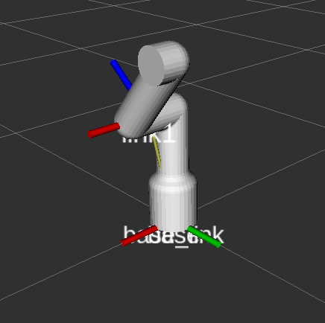
Activity
Introduction
In this activity, the student will learn how to simulate a single link manipulator dynamics using the governing equations derived from the Euler-Lagrange methodology.

Slide 3
SLM Simulation in RVIZ
Download the package “slm_sim”, from GitHub “Week4/Activities/Activity 2” to your “catkin_ws”
Create a node called slm_sim.py inside the scripts folder
cd ~/catkin_ws/src/slm_sim/scripts/
touch scripts/slm_sim.py
Give executable permission to the file
cd ~/catkin_ws/src/slm_sim/scripts/
sudo chmod +x slm_sim.py
Modify the CMake file to include the newly created node in the
catkin_install_python(PROGRAMS scripts/slm_sim.py
DESTINATION ${CATKIN_PACKAGE_BIN_DESTINATION})

Slide 4
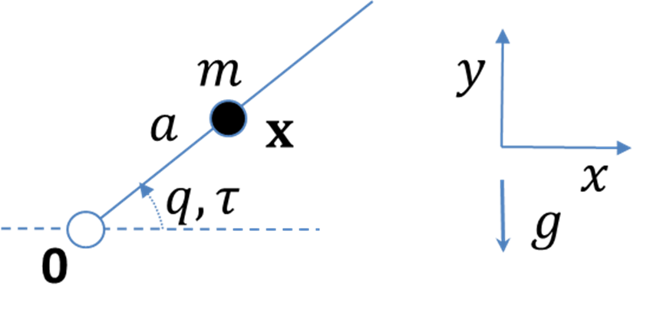

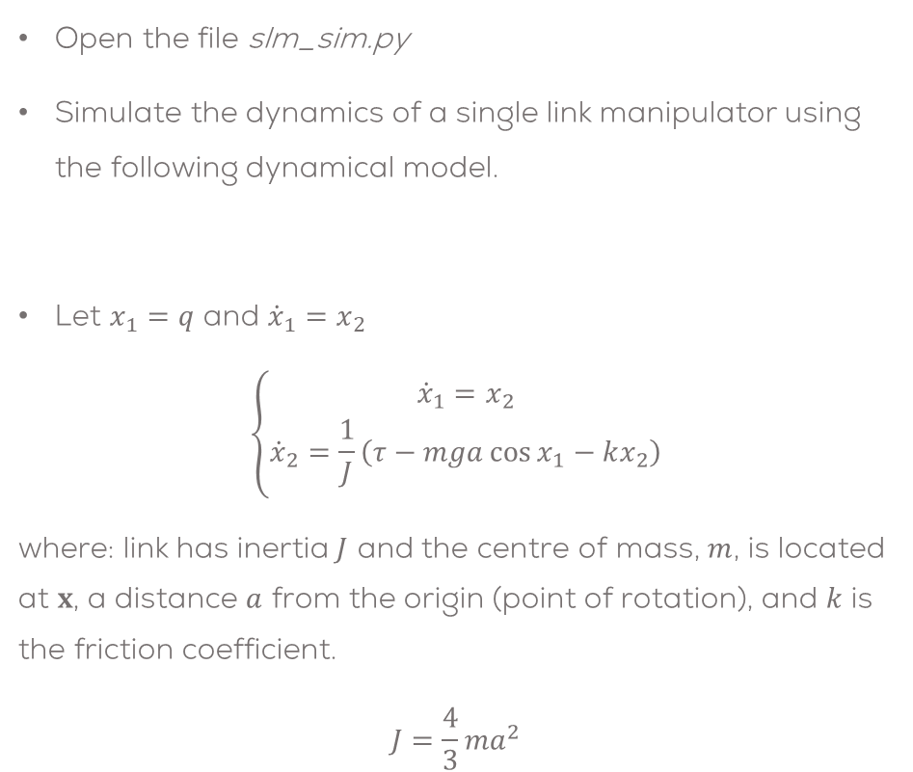
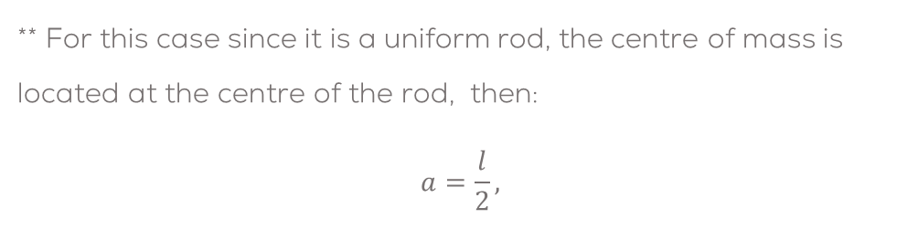

SLM Simulation in RVIZ
Open the file slm_sim.py
Simulate the dynamics of a single link manipulator using the following dynamical model.
Let $x_{1}=q$ and ${{\dot{x}}_{1}=x}_{2}$
$$\left\{\begin{aligned}{\dot{x}}_{1}&=x_{2} \\ {\dot{x}}_{2}=\frac{1}{J}\left(τ−mga\cos{x_{1}}−kx_{2}\right)\end{aligned}\right.$$
where: link has inertia $J$ and the centre of mass, $m$, is located at $x$, a distance $a$ from the origin (point of rotation), and $k$ is the friction coefficient.
$$J=\frac{4}{3}ma^{2}$$
$$l$$
$$J\ddot{q}+k\dot{q}+mga\cos{(}q)=τ$$
** For this case since it is a uniform rod, the centre of mass is located at the centre of the rod, then:
$$a=\frac{l}{2},$$

Slide 5
SLM Simulation in RVIZ
#SLM Parameters
k = 0.01
m = 0.75
l = 0.36
g = 9.8
Tau = 0.0
x1 = 0.0
x2 = 0.0
#SLM governing equation
x1 += x2*dt
x2_dot = (1/(J+ma^2)) * (- mga cos(x1) – kx2 + Tau)
x2 += x2_dot*dt
/tau
SLM Manipulator
/joint_states

Slide 6
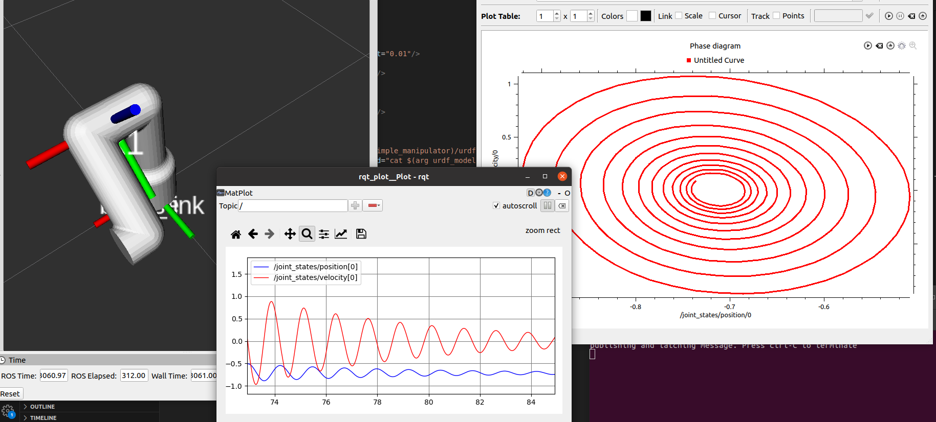
SLM Simulation in RVIZ
Subscribe the model to the topic “/tau” and publish the model’s output in the topic “/joint_states”.
Make sure to add print some values to verify the program is working properly (debug).
Compile the program
cd ~/catkin_ws
catkin_make
Launch the node from the launch file
roslaunch slm_sim pendulum_sim.launch
Open rviz and rqt_plot to verify the results
rosrun rqt_plot rqt_plot
rqt_multiplot can be installed to view the phase diagram
sudo apt install ros-noetic-rqt-multiplot
rosrun rqt_multiplot rqt_multiplot

